Slide 1


KENNE-ELECTRIC LLC
​Address :
​Headquarter : 200 Haddonfield Berlin Road, Suite 2 Voorhees NJ 08043,USA
Website: www.kenneelectric.com
telephone: (001) 856-278-3591
Business email: k.electric@kenneelectric.com
​Branch 1: 10130-204 Douglas oaks circle , Tampa FL 33610,USA
Branch 2: 216 Rue Albert Ateba Ebe, Nlonkak,Yaounde Cameroon
​PO.BOX: 3438 Yaounde Cameroon
​Telephone: (237) 699 99 87 09 /674 94 29 41

Slide 2
general purpose identification and localization system
I center Africa (Cameroon in particular), many people remain without identity and physical address documents – poor people especially.
In order to include all people living in Cameroon, we propose a valid identification and localization system (inclusive) [which do not exist], a multipurpose national identification and localization system call Online ID system that give to all people:
1 – a unique identification number
2 – a Physical address

Slide 3
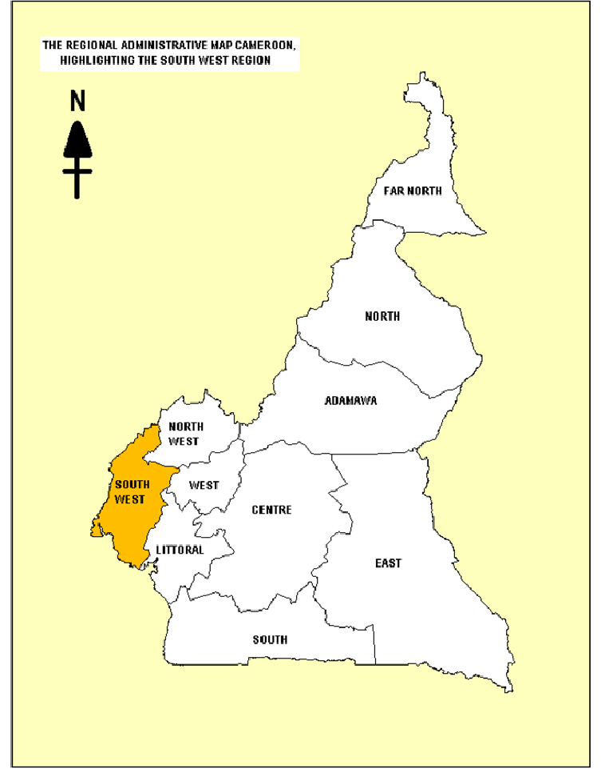
Ivan Junior ID: CM 336 145 1 143567 0045 Biyem assi, Yaounde, 33610 Cameroon

Slide 4
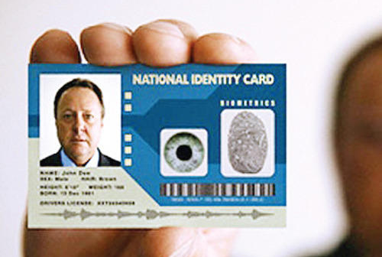
National Identity and location Card

Slide 5
POC (PROVE OF CONSEPT)
PROJECT
DEVELOP A POC OF A GENERAL PURPOSE IDENTIFICATION AND LOCALIZATION SYSTEM FOR PEOPLE LIVING IN A SPECIFIC AREA
PRODUCT
ONLINE IDENTIFICATION AND LOCALIZATION SYSTEM
PRODUCT NAME
ONLINE ID
PRESENTATION: BLONDEL KENNE DATA SCIENTIST USA

Slide 6
VISION AND MISSION STATEMENT OF THE ONLINE ID SYSTEM
VISION
Advance the use of Machine Learning and Artificial Intelligence(ML +AI ) to transform the Cameroonian’s society and improve the Quality of life .
Technology have one objective : Improve the life condition of human being
MISSION
To advance ML +AI by providing High quality platform , services and Product by promoting Innovation and high-tech for Business ,Government ,Organization and the Civil Society

Slide 7
INTRODUCTION
Some thought
You can avoid reality and the truth but you can not avoid the consequences of avoiding reality or truth (AYN RAND)
We under estimate how fast technology can come and transforms everything
What is the speed of technology ?
Can we measure the speed?

Slide 8
SPEED OF TECHNOLOGY
25000 YRS/AGO | 15000 YRS/AGO | 5000 YRS/AGO | 2500 YRS/AGO | 1900 YRS/AGO | 325 YRS/AGO | 95 YRS/AGO | 65 YRS/AGO | 38 YRS/AGO | 15 YRS/AGO | 12 YRS/AGO
FIRST TEHNOLOGIE EMERGE PAINTING AND DRAWING | AGRICULTURE | WRITING WHEEL | ORGANIZED SOCIATY, CITY, STATE, COMMUNITY …ETC | EXPERIMENTAL METHODE | INDUSTRIALISATION | INVENTION OF ELECTRICITY, RADIO AND TELRPHONE | FIRST VACUM TUBE PRIMITIVE COMPUTER | PRIMITIVE COMPUTER TO MODERN COMPUTER | MODERN COMPUTER TO INTERNET | FROM INTERNET TO SMART PHONE, CLOUD COMPUTING,IOT
LAW OF ACCELERATING RETURN
THE MORE ADVANCE WE BECOME , THE FASTER VE BECOME ADVENCING
Technologies is an accelerating forces
The futures is approaching us faster and faster all the time
The reality is this
When knowledge is free only your ideas are worth paying for

Slide 9
4th INDUSTRIAL REVOLUTION
* Capability to stores and handles quasi- infinite amount of data
* The speed (instantaneous processing speeds)
* The mobility of such devices as embody surch technology
* Runaway speed technology development
* Complexity of data handle
* Development of stream power vs development of Artificial Intelligence and Machine Learning
FONDAMENTALLY TRANSFORME OUR ECONOMIE SYSTEM

Slide 10
New Industrial ages with Machine Learning and Artificial Intelligence(ML,AI)
* Automation of vas number of tasks traditionally intellectual
Exertion – Data analysis – Prediction – Information processing – Learning of better
About 50% of current jobs (traditionally Intellectual worldwide are susceptible to automation within 20 years
Rise of robot
Machine Learning (ML) + Artificial Intelligence(AI) come to dominate the economies
Need to analyze claim and assess the future of ML + AI in economies
* Qualitative difference in nature of AI technology to any technology

Slide 11
ML and AI
AI +ML is not a complement for labor as a whole by being a substitute for certain routine within the task of labor. It is not an extension of the range of human capacity
It is a substitute of labor of labor period
It is substitute for laborer
AI is the replication of human thought process in the representation of a algorithm in the working of a physical process
The mind tends to operate in a algorithmic manner
ML recreate the workings and evolution of an Intelligent activity
Minimizing the error between Prediction and actuality in a physical process allows to replicate Learning in a machine

Slide 12
PURPOSE OF THE ONLINE IDENTIFICATION AND LOCALISATION SYSTEM
Alternative to government ID
Enforcement to government ID
Provide data to government to maintain order and security
Create an ecosystem of Industries innovations
Build credibility though :
1 – Identity authentication and ease market-base transaction
2- Ease participation in a formal economies
3- Enable search, Identification, Localization, screening , monitoring security and safety

Slide 13
Give access to public services
Enable business to create and collect data for data center, data base and data set for business purpose
Eliminate fake identification ,loss of money and credibility
Give the opportunity to poor or less favorable social class to access job, public service and government help

Slide 14
FEATURE OF THE ONLINE ID CARD
Unique ID
Record, Monitor and screening
Authentication and unique identification with biometry information(photo, all 10 finger print, both iris and particular sign
Robust enough to eliminate duplication and fake ID
Can be verify and authenticate in an easy cost effective way

Slide 15
Comparing to existing ID system
The current ID system are costly and are not secure. It is subject to manipulation, does not give the ability to perform data mining, ML + AI

Slide 16
GOAL OF THE ONLINE ID SYSTEM
TO CHANGE THE FACE OF IDENTIFICATION, AUTHENTIFICATION AND LOCALISATION SYSTEM IN AFRICAN
TO GIVE ALTERNATIVE TO BUSINESS TO TARGET COSTUMERS , TO GORVERNMENT AS WELL AS TO AUTHORITY THE ABILITY TO HAVE A VISIBILITY ON THEIR POPULATION

Slide 17
PARTNERSHIP
GORVERNMENT
TECHNOLOGY FIRM
PUBLIC SECTOR
PRIVATE SECTOR
CIVIL SOCIETY AND COMMUNITY NETWORK
ORGANISATION

Slide 18
MODEL: ONLINE ID CARD
Unique lifetime biometric base Identification card
12 to 15 digits numbers
CARD: Online, Virtual ,Physical , printable , DYNAMIC

Slide 19
ID CARD
FRONT
PERSONAL INFROMATION
HIER
Country-code
uEIC
Online ID
FINGER PRINT
ID number
PICTURE
PARTICULAR
SIGN
IRIS
CHIPT PIN

Slide 20
#
BAR CODE
Country specific code , information and mape
Reference and special code
BACK

Slide 21
Country Specific Code, Residence, Ethinity, Gender for Identification
RESIDENCE INFORMATION
COUNTRY SYMBOLE : 2 SYMBOLS
REGION, DEPARTMENT , ARRONDISSEMENT, COMMUNE : 3 digits
ETHNICITY INFORMATION
DISTRIC , VILLAGE , ETHNIC: 3 digits
GENDER
Random NUMBER: 6 to 8 digits
Sex : 1
Example: CM 111 111 1 XXXXXX
Cameron - Groupe By Community of Residence – Village of origin - Gender –
Unique Random Number

Slide 22
Virtual Residence Map to Physical Location For Location and address
https://en.wikipedia.org/wiki/Departments_of_Cameroon
GEOLOCATION
Paring of IP address to a Geographic location
Identify where the ID com from and where is the physical location of the ID holder with Geolocation information
Reduce risk base on geolocation
Locate source of ID

Slide 23
Ivan Junior ID: CM 336 145 1 143567 0045 Biyem assi, Yaounde, 33610 Cameroon
Granularity
Groupe by : REGION – DEPARTMENT – ARRONDISSEMENT – COMMUNE
CODE : 9 DIGITS IN TWO GROUPE
Groupe 1 : 5 digits for each commune
Groupe 2 : commune specific code
Example
Online ID : CM111 111 1 111111(plus 2 digits extention0
Name : ID card holder Name
Address : Groupe 2 code Biyem assi , Yaounde Groupe 1 code , Country

Slide 24
INFORMATION ON THE ONLINE ID CARD
NAME: name of the card holder
DOB: date of birth of the card holder
PLACE: place of birth of the card holder
SEX: sex of the card holder
ID# identification number of the card holder
MOTHER NAME: name of the cardholder’s mother
FATHER NAME: : name of the cardholder’s father
ADDRESS: current living address of the card holder
WEIGH: weight of the card holder
HEIGHT: height of the card holders
ISSUE: issue date of the ID card
ALL 10 FINGER PRINTS

Slide 25
BOTH IRIS
CURRENT PHOTO ( IMAGE, PICTURE)
PARTICULAR SIGN
CHIPT PIN
Current phone number
Email address

Slide 26
INFORMATION ABOUT THE ONLINE ID CARD HOLDER
Biographic information form
Education information form
Biometric information form
Demographic information form
Personal information form ( email, phone#, name, address(physical, virtual, mailing ),gender, date of birth, place of birth, nationality and ethnicity)

Slide 27
IMPEDIMENTS AND OTHERS CONSERNS
Cost –benefit or feasibility studies to insure the project meets its goals
Security concern/social benefit schema test
Quality of biometric data to be collected
Must be profit making
Need a cost benefit – analysis of the Online ID Card System( total cost, total expenditure, total benefits per/year, )
Legislation and privacy concerns
Legality of sharing data with law enforcement , Government, Business , Organizations and Civil Society
Overlaps with other national Population system
Fraud
Access to every one specially poor person who lived in inaccessible area
Application issue( should be free to all citizen
Develop application, Mobile application to provide interface to the ID system

Slide 28
Exclusion : list of require document to be accepted for identification applying to KYC(Know Your Costumer)
Data Leaks: protection again criminal to access sensitive information

Slide 29
TECHOLOGY
The ID Card System need:
Big data processing capability
Large scale computing /distributed/scalable/system
Distributed storage
Keys basic for competition: analyzing big data
Prioritize big data project that benefit from HADOOP

Slide 30
TECHNOLOGY – HADOOP ECOSYSTEM
Central part of many Big Data project
Used Hadoop ecosystem to integrate Hadoop frame work with more traditional relation databases
Frame work of tools that allows for the distributed processing of large data set across cluster computer using simple programing language

Slide 31
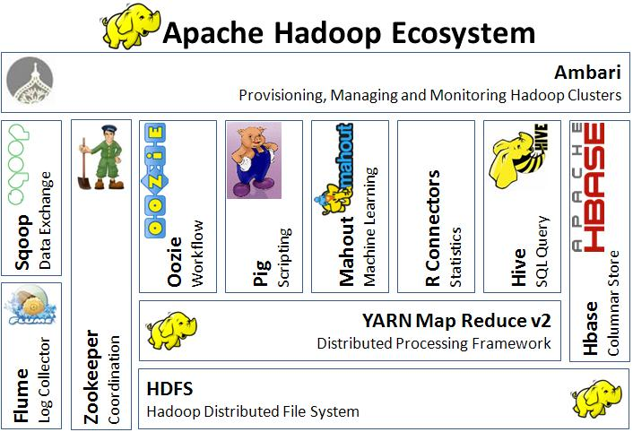
TECHNOLOGY - HADOOP

Slide 32
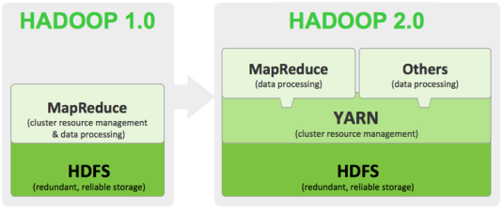
TECHNOLOGY – HADOOP ECOSYSTEM

Slide 33
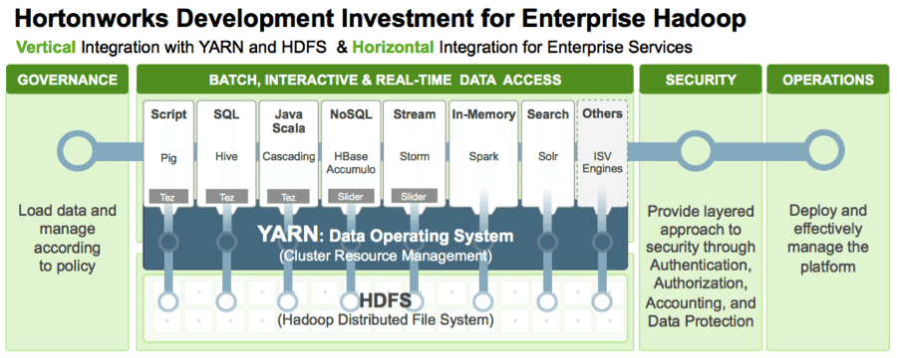
TECHNOLOGY – HADOOP ECOSYSTEM
Source “https://hortonworks.com/blog/data-science-apacheh-hadoop-predicting-airline-delays/”

Slide 34
TECHNOLOGY – DATA STORAGE
STRUCTURE DATA BASE
DB2
MS SQL
SQL SERVER
ORACLE
MYSQL
SQLITE
UNSTRUCTURE DATA BASE
MONGO DB document based
APACHE CASSANDRE column based
REDIS/MENCASHE key- value pare based
NEO4J graph based

Slide 35
Main type of No-SQL database
Wide – column store: use column to store data
Document store : use json, xml, bson document to store data
Key-value store: store data in a unique key-value pairs
Graph store: use nodes that contain list of relationship records
Multi –mode: combine the four types for more flexibility

Slide 36
TECHNOLOGY – DATA GORVERNANCE
Data Profiling Data Quality
Dignosis of existing data in store to understand it compleness , uniqueness pattern, periodic process
Registering a data
Creating a data base
Creating and verifying policy for data profiling
Creating job flow for data profiling
Applying data profiling rules
viewing profiles data
Viewing data quality score

Slide 37
Data Masking
Static Masking , Dynamic Masking
Sensitive document
Data masking sofware
Masking version

Slide 38
TECHNOLOGY – DATA SOURCE
EVENT: THING LOG REPRESENT
Log from servers, users transactions, users locations, users identification, action the user take, system generated event, form the users fill, survey question the users answer, audio, video, photo, text, document created
EXAMPLE
Digital personal information form
Digital Biographic information form
Digital Demographic information form
Digital Biometric information form …etc

Slide 39
d
Structured
Unstructured
Storages
Avro, thrift, protobuf…
collector
Digital
form
Event
Web base event

Slide 40
TECHNOLOGY – DATA PROCESSING
BATCH - INTERACTIVE – REAL TIME DATA ACCESS
METHODOLOGY
EMBEDDED ANALYTIC
LIVE QUERIES EMBEDDED API SSO INTEGRATION
DATA WAREHOUSE DEPLOY ANALYSE

Slide 41
EMBEDDED ANALYTIC
Advantage : reusability, scalability, customize
Massive data movement
Specialized ETL tools
Data munging
Redundancy

Slide 42
TECHNOLOGY – SYSTEM ARCHITECTURE
TWO APPROACHES FOR HADOP ECOSYSTEM
BUILD YOURSELFT: get all Hadoop ecosystem tools , put together (open source software) FREE
GET APPLIANCE : from vendor and pays maintenance and support fee( MAPR, CLOUDERA, HORTONWORK …)
Either way you need System Operator, Data Engineer, Data architect
THREE APPROACHES FOR CLOUD COMPUTING
IAAS(Infrastructure as services)
highly scalable and automated computing resource
You rent Server –Computer – Memory – Disk –Network … and pay/period
You can access servers, storage … directly but outsource through Virtual Data Center
Give clients complete control of their infrastructure
You install your own application and resource are available as services
Vendors(AWS, RACSPACE, MS, IBM, GOOGLE …)

Slide 43
PAAS(Platform AS A Services)
Provide application, you can install and use your own application and manage it
Develop run and manage application
Provide platform for software creation over web
No complexity of building and maintaining infrastructure
SAAS(Software AS A Services)
The most commonly utilized option for business on the cloud
Use internet to deliver application to the users
Manage by third party vendor
Do not require any downloads or installation on the client side
Stream line maintenance and support

Slide 44
WHEN TO USE IAAS
Start up of small company (stop spending time creating hardware and software)
Large organization that want control over their applications and infrastructure as needed
Insure about what demand an application will need as there is a lot of flexibility to scale up Down as needed
ON PREMISE DATA CENTER
Build own data center
A centralized location where computing and network is concentrated for the purpose of
Collecting, storing, processing, distributing or allowing access to large amount of data
DESIGN CONSIDERATION
Energy use , network infrastructure management , data center infrastructure management, managing the capacity of the data center
COMPONENTS
SERVERS RACK – NETWORK CONNECTIVITY – SECURITY SYSTEM – MONITORING AND COOLING SYSTEM – POLICIES AND PRECEDURES

Slide 45
INFRASTRUCTURE
APPLICATION
On premise data center
infrastructure for cloud computing
DATA
RUNTIME
MIDDWARE
O/S
VIRTUALIZATION
SERVER, RACK
STORAGE
NETWORK

Slide 46
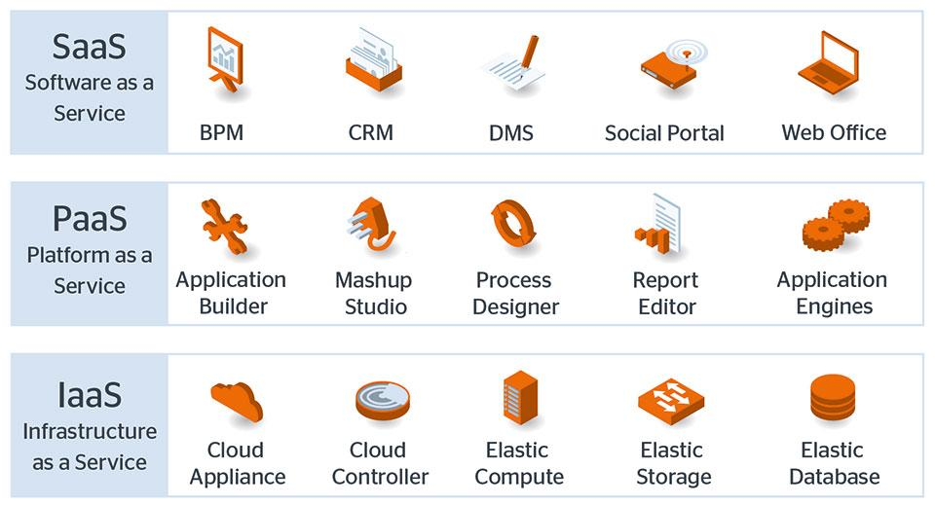
CLOUD PLATFORM

Slide 47
ECONOMIC IMPACT OF DATA HANDLING TECHNOLOGY
 | DATA CENTER | CLOUD COMPUTING(IAAS)
Net rental square/feet(NRSF)
Capital expenditure
Initial capital expenditure
Land acquisition
Construction building
IT equipment
Annual operation expenditure
Power
Staffing
Real estate tax and insurances
Maintenance administration
Tax
Other services rent for data
Data services(IAAS)

Slide 48
ECONOMIC IMPACT OF TYPICAL DATACENTER VS CLOUD COMPUTING TO LOCAL COMMUNITY
 | Construction phase | 18 -24 Moth | Operational Phase | annualy
 | Data Center | Cloud Computing | Data Center | Cloud Computing
Local jobs
wages
Local economies activities
State and Local Taxes
Technologies transfer cost

Slide 49
THECHNOLOGY –MODEL SELECTION
SELECTED TECHNOLOGY MODEL
DATA CENTER
SUGGESTED PLACE OF OPERATION: CAMEROON
NETWORK AVAILABLE: CAMTEL TELECOMMUNICATION NETWORK
INFRASTRUCTURE AVAILABLE:
NETWORKS = 8000KM OF FIBER OPTIQUE CABLE IN THE COUNTRY ON 475500KM2
OBJECTIVE 20000KM
RATE = 4000KM/YEAR
UNDERWATER FIBER OPTIC CABLE (CAMEROON- BRESIL), ACE, (CAMEROON –NIGERIA)
DATA CENTER :NOT AVAILABLE

Slide 50
TOPOLOGY OF DATA CENTER
ZONE – REGION – GLOBE
ZONE = Small data center
REGION = Medium data center
GLOBE = large data center
Classification according to Cameroon
Department and commune = Small data center
Province Region = medium data center
State = large Data center

Slide 51
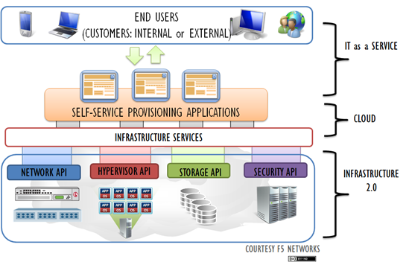
DATA CENTER

Slide 53
SCIENCE - ANALYTIC
ETL(Extract Translate and Load )
BI(Business Intelligence)
SQL(Sequel Query Language)
ML +AI (Machine Learning +Artificial Intelligence)
Data Mining
Risk Mitigation
Data Management
Systematic process adaptive approach(Build ML into Decision making – Learn System –Model System
Apply systematic approach to any system(New technique to Predict and explain …,framework ML for business application
CLIENT ARCHECT TYPE
Seeking descriptive, predictive and prescriptive analytics to:
Understand business problems as a system – increase profitability – make –better decision – mitigate data risk – convey insight to stakeholder – increase the standard of living

Slide 54
